Slide 1
WELCOME
TO
Sree Sai Logistics

Slide 2


Slide 3
SREE SAI LOGISTICS

Slide 4

SREE SAI LOGISTICS HAS SET UP BUSINESS IN THE YEAR 2013, 4TH OF APRIL.
IT’S A PROPRIETORSHIP FIRM.
THE COMPANY’s FOUNDER IS HAVING MORE THAN 20 YEARS EXPERIENCE IN ROAD LOGISTICS.

Slide 5
Background and Development
This company started with 2 Customers. They are M/S Tanishq Steels Ltd, Hyderabad and M/S Vishnu Enterprises, Chennai. We at transportation take Special care in undertaking the Customer needs. Customers have come to count on our expertise in Placement of vehicles as per their requirements and Our willingness to work in total co-operation towards delivering the material in-time and good conditions.

Slide 6
Over a year we have been able to distinguish
Ourselves as leading transporter in excellence
Transportation and customer care. In our zeal to
Expand our wings and cater to the constant demand
From clients, we have also been actively engaged.
This helps us to make the sales in FY – 2013-14
Rs.175.97 lacs with the net profit of 5.08 lacs. In
FY – 2014-15 Rs. 185.82 lacs with the net profit of
Rs. 5.51 lacs, In FY – 2015-16 Rs. 705.00 lacs and FY –
2016-17 we will be achieving above with better profit
Compare to previous FY’s.

Slide 7
QUALITY POLICY
We are committed to providing safe, dependable
Transportation service to our customers and to
Meet our goal, organization shall strive.
Prompt and positive response
Team performance
On time delivery of goods
To reduce customers complaints
With a mission to make continual improvement
In all aspects

Slide 8
PRESENT CONDITIONS:
A commitment to uncompromising quality, responsive service, competitive pricing through continues innovation in process, motivated work force efficient marketing in placement of vehicles is made us ahead in our mission to excel in our chosen field. Present we are doing the business with 20 parties. They are as listed below:

Slide 9
M/S TANISHQ STEELS LTD, HYDERABAD
M/S VISHNU ENTERPRISES, CHENNAI
M/S TEJAS WIRES PVT LTD, MEDAK
M/S ESSAR PROJECTS, MATTANUR
M/S INTERNATION STEELS EXCHANGE, CHENNAI
M/S S L R METALICS, HOSAPETE
M/S MEGHA ENGINEERING & INFRASTRUCTES PVT LTD, RAJAMUNDRY
M/S V S P REBARS, GUNTUR
M/S TIRUMALA STEELS, VISHAKAPATNAM
M/S KIZHAKKITHIL PVT LTD, KOTTAYAM
M/S EMIRATES STEELS PVT LTD, ALLAPUZHA

Slide 10
M/S R K ASSOCIATES, PUDUCHERRY
M/S ANU FASTNERS, HYDERABAD
M/S R K STEELS UDYOG PVT LTD, HYDERABAD
M/S SATVA ENGINEERING LTD, MADHURANTAKAM
M/S GEECO ENERCON LTD, TANJAVUR
M/S GEEKAY WIRES, HYDERABAD
M/S GODAVARI STEELS, HYDERABAD
M/S B M M ISPAT LTD, HOSAPETE
M/S NAGARJUNA STEELS LTD, HYDERABAD

Slide 11
SCOPE OF WORKS:
Our company parellely handing the transportation are now handling Rake Shipments also. Succeeded in it and got a good Appreciation with the Customers at Daroji Railway Siding
We have started other rake handlings from various stations too.

Slide 12
Execution of Rake Handling Images for Reference

Slide 13
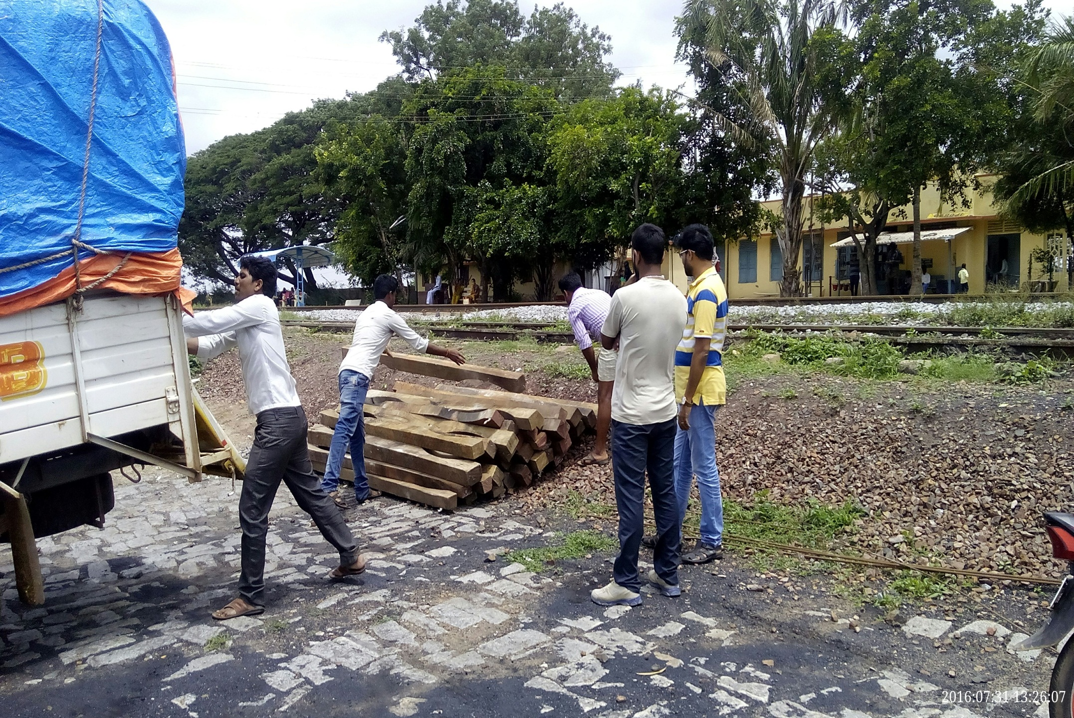

Slide 14
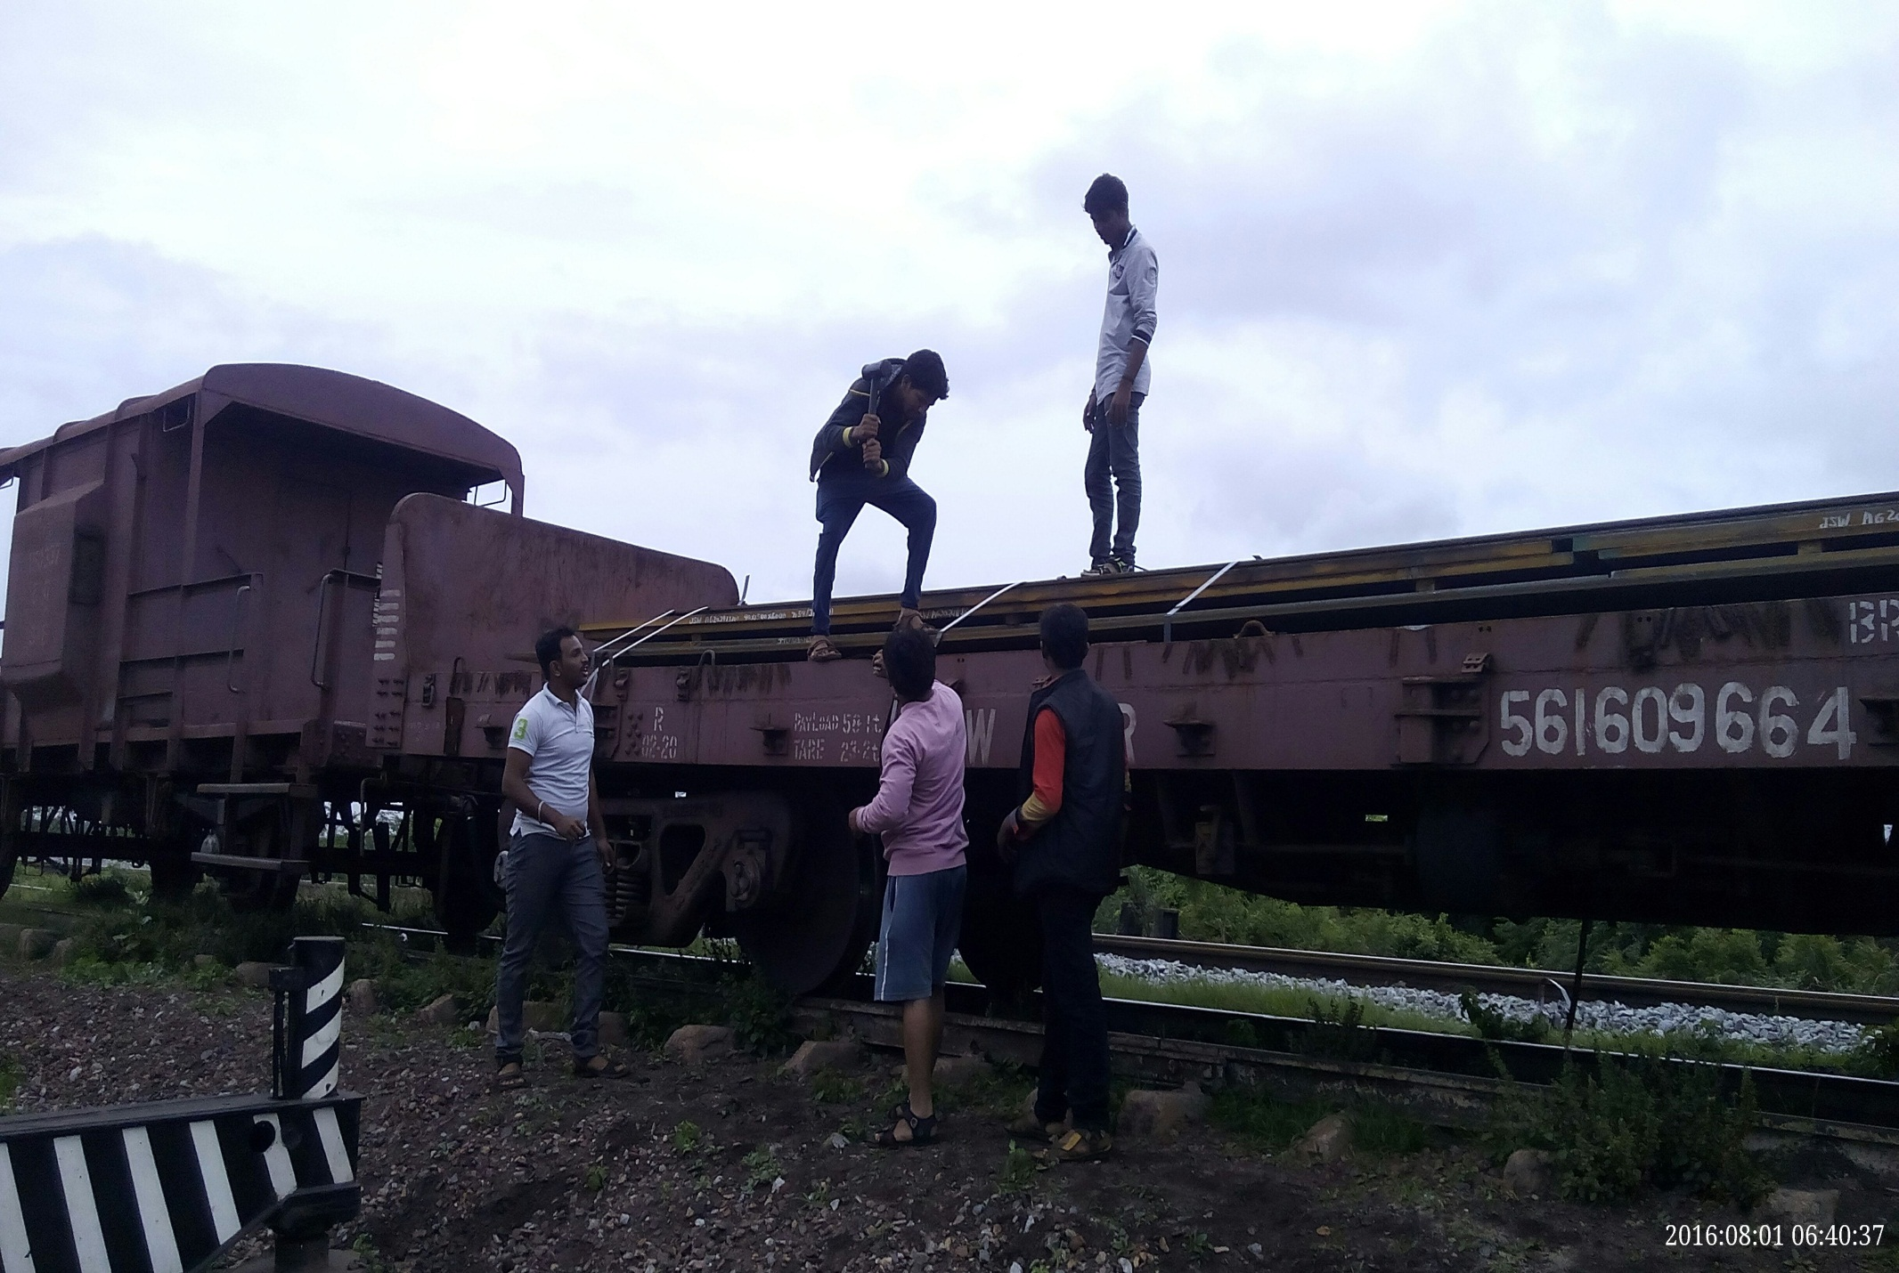

Slide 15
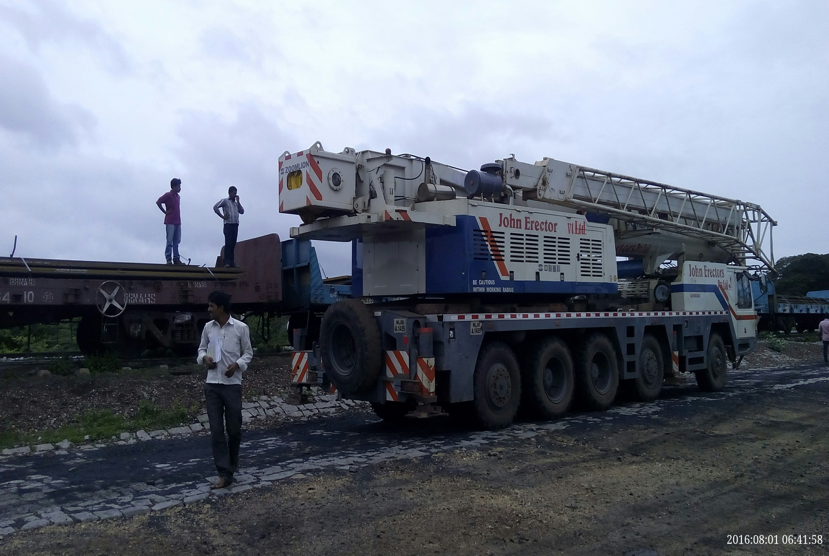

Slide 16
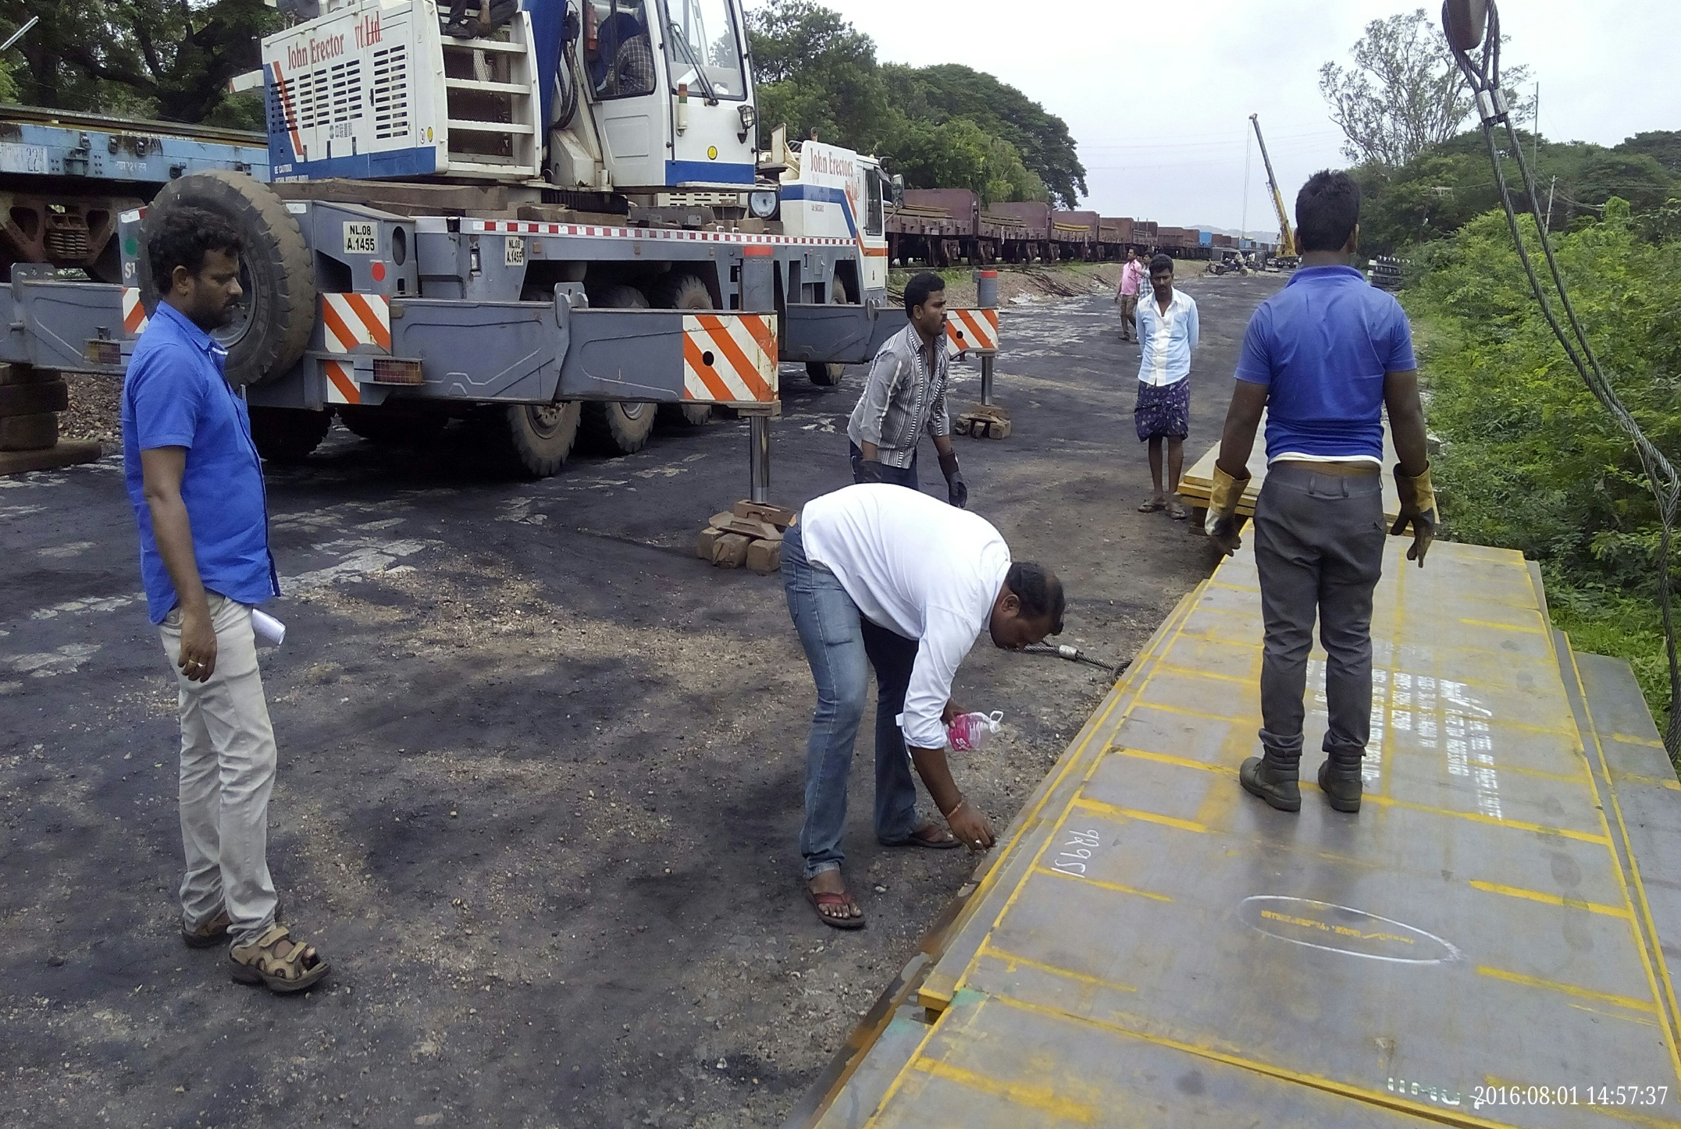

Slide 17
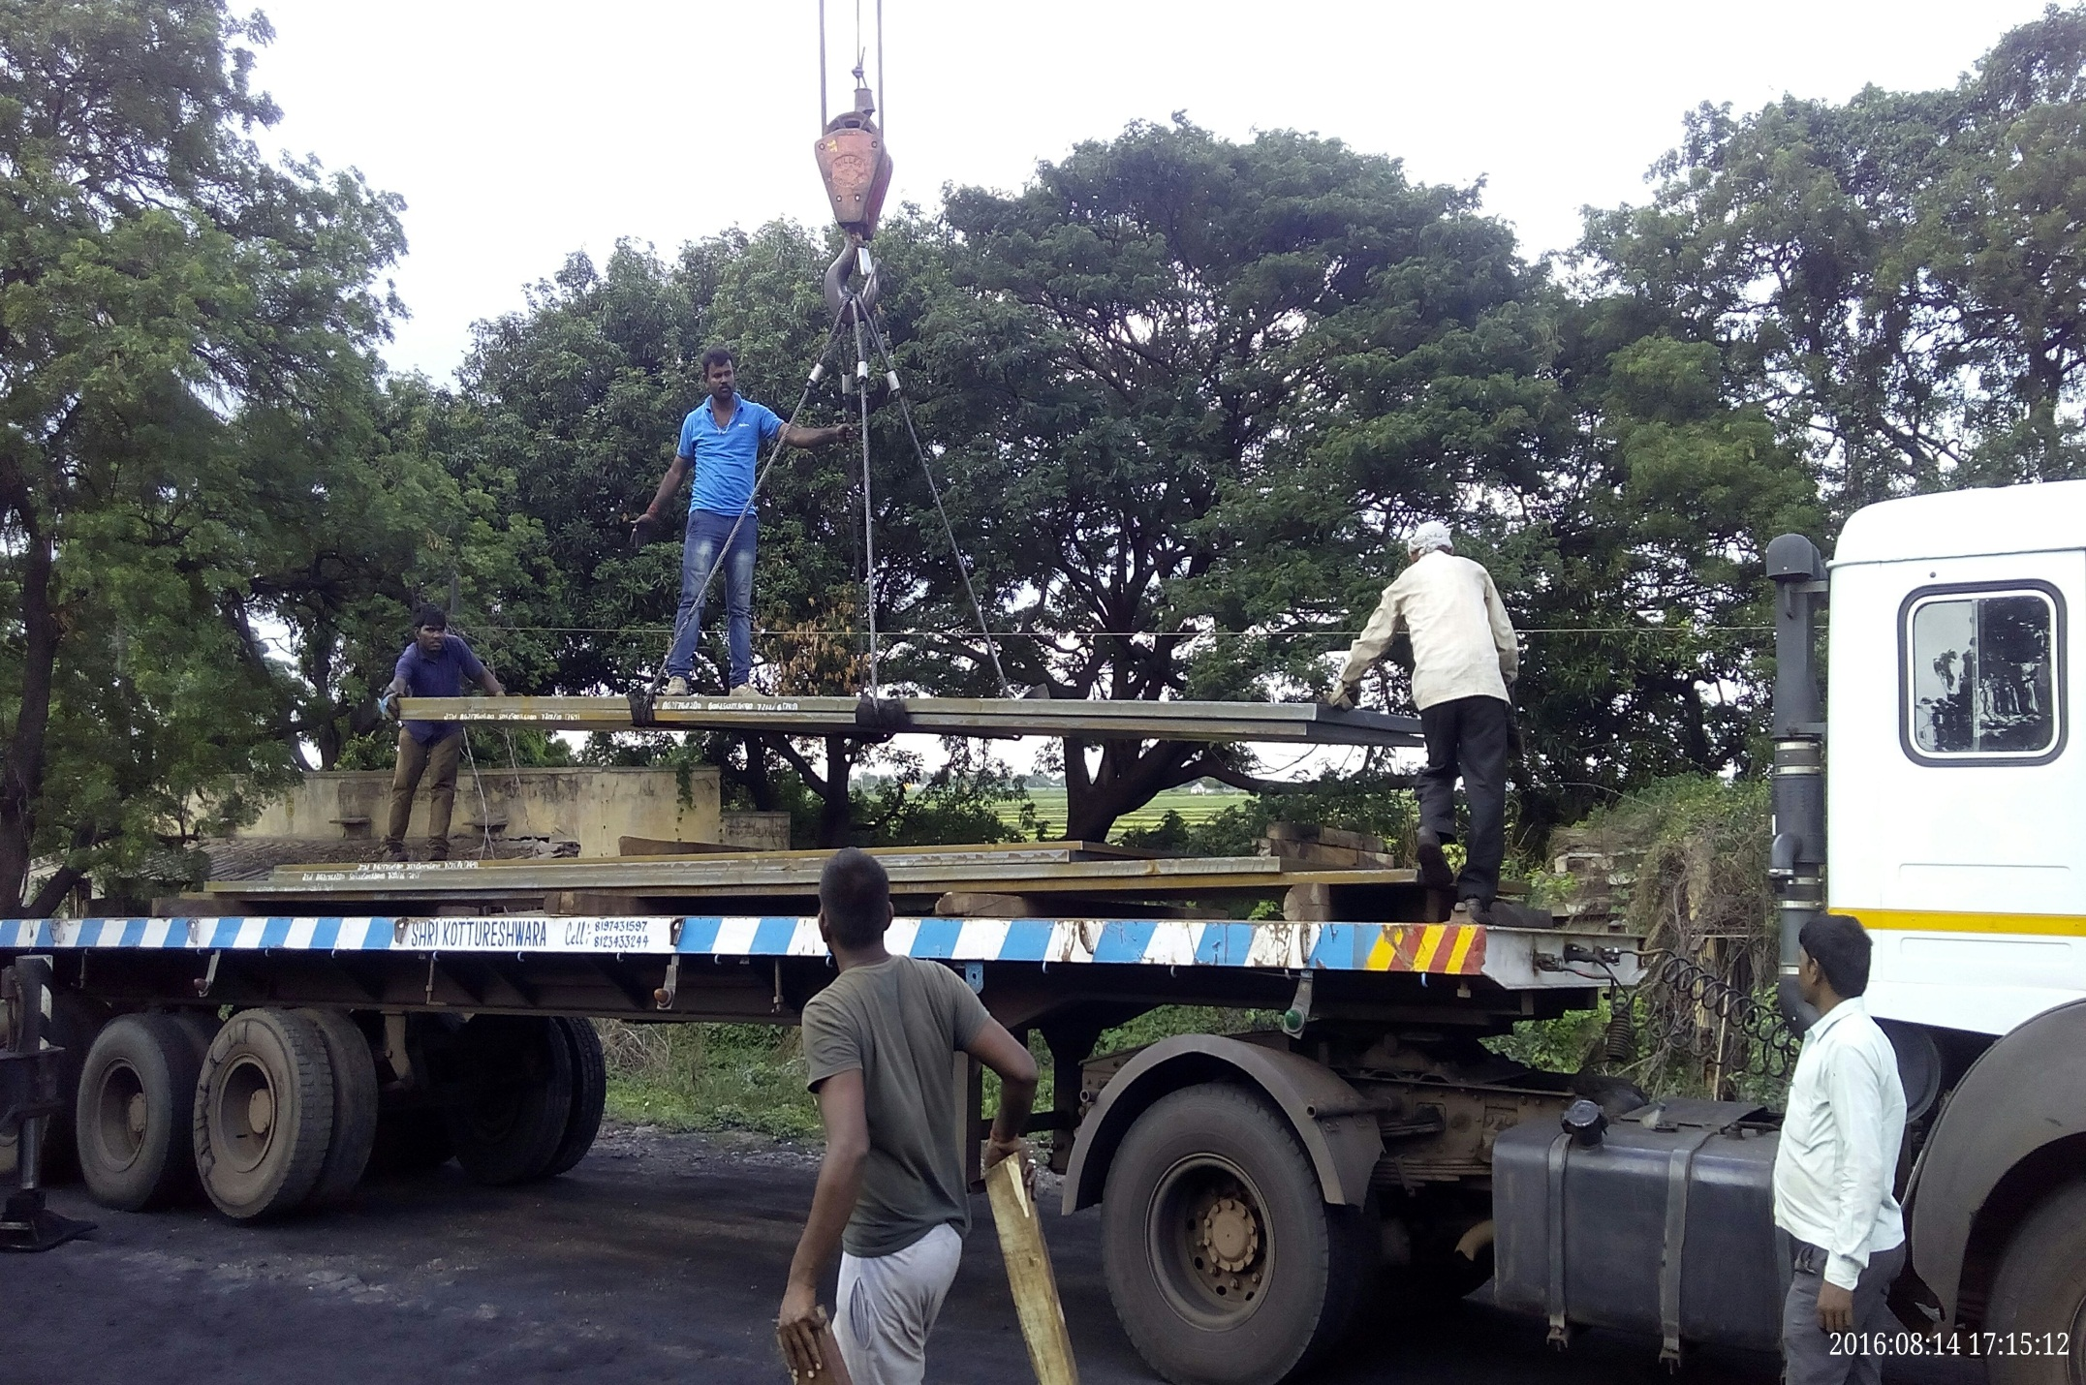

Slide 18
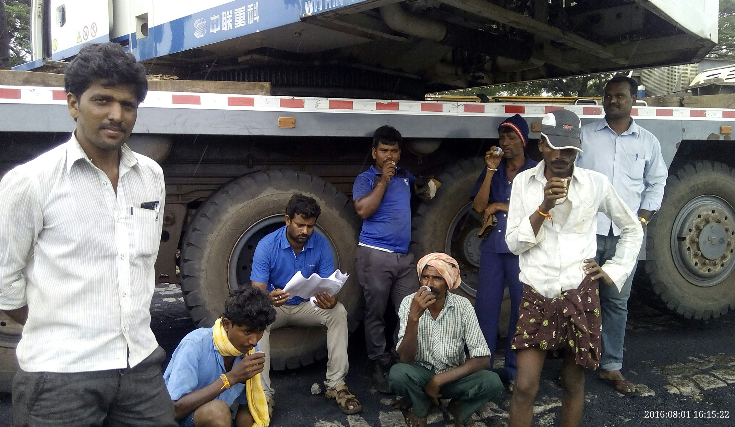
SUCCESSFULLY EXECUTED

Slide 19
OUR VISION:
Our vision is to become the Indian MultiModal Logistics, a global leader in logistics, connecting to the major hubs of the world. With unmatched infrastructure, cutting edge technology and innovative solutions. We aim to provide our customers with complete transportation solutions, REDEFINING INDUSTRY STANDARDS.

Slide 20
OUR MISSION:
Our Mission is to move our Clients Goods safely through environment friendly initiatives and within guaranteed time.
We are Focusing on Different type of Business Opportunities if offered

Slide 21


